Slide 1

Think Like a Certification Exam
#DataWeekender #ExamCram - 24th Jan 2023
William Assaf, Microsoft

Slide 2
Pop Quiz
You are a member of the Council of Elrond.
You must choose someone present to bring the One Ring to Mordor. One does not simply walk into Mordor. The ring-bearer must not be desirous to use the ring to help their own kingdom. The ring-bearer must not own another of the Rings of Power.
You need to choose a ring-bearer.
Who should you choose?
A. Smeagol
B. Boromir of Gondor
C. Frodo Baggins
D. Gandalf the Grey
Notes:
Pop Quiz!
<read slide>
<click>

Slide 3
Agenda
What exams try to test
Who exams are for
New Microsoft certs resources
How to prepare for exams
How Exams are Written
Deconstructing the wrong answers
Fun sample exercises
Content is not specific to Microsoft
Notes:
Content is not specific to Microsoft technologies and exams, though that is where my experience lies as a consultant, as a certified pro, and as an exam item writer, and now an employee.

Slide 4
Certified Technology Professionals
Certified employees are 17% more productive.
Certified reduce unplanned downtime by 56%.
Certified employees are generally more satisfied with their jobs and enjoy tenures that are 15% longer than uncertified.
60% of employers use certs to confirm expertise.
Certified IT Pros get promoted 50% faster than non-certified.
Microsoft Learning White Paper http://download.microsoft.com/download/9/4/B/94B5442E-0494-4B42-A5DC-8742E4254B09/BVW-Microsoft-US40548315.pdf
CompTIA HR Perception of IT Training and Certification Study: 2015 https://certification.comptia.org/docs/default-source/downloadablefiles/hr-perceptions-of-it-training-and-certification.pdf
MICROSOFT CERTIFICATIONS DATA SHEET Ten reasons to earn a Microsoft Certification https://query.prod.cms.rt.microsoft.com/cms/api/am/binary/RE4FRd2
Notes:
<read notes instead>
Here are some statistics from both Microsoft and CompTIA talking about employees who are certified being more productive, responding better, having better careers, being respected by employers. Does a certification make you a better database administrator per se? No, I’m not implying causation here, but the process of preparing for an exam, the preparation of the materials, and the mindset that led you to the self-improvement path of the certification exams, those are all productive, causative, and beneficial for your career. So good for you for attending this session today and probably feeling the need to get certified.
A final note I’d say is that becoming certified makes your skillset broader, more aware of features, and potentially better at choosing the right solutions for the right problems.

Slide 5
What Exams Try to Test
When deciding on exam content, SMEs are asked: “Is this a skillset that you do regularly?” or “Is this a skillset you would ask for when hiring?”
If a group of worldwide SMEs does not think a feature is important, it’s doesn’t go on the exam.
However, new features for new versions are likely to be included on the exam, to certify people working in the newest version(s).

Slide 6
Before and After the exam is live
SMEs used in all phases of exam development.
In Beta and when the exam is live, question success and feedback is analyzed by a psychometrician.
New product capabilities/features often get a special focus on exams.
Notes:
<read notes>
Microsoft subcontracts out SMEs globally for various phases of question development. Topics are removed from the exam’s domain if none of the SMEs present could say they use it in real life. SME’s are asked questions about the value of different technical topics.
Then, how many questions on each subject area should be there in the domain?
Item Writers are given assignments to cover a narrow domain, like, write a question about automating maintenance tasks with a SQL Agent job.
Then a review process and alpha exam process occur with yet another group of SMEs to fine tune the items.
<click, read slide then notes>
At Microsoft her name is Liberty Munson, she’s an I/O Psychologist.
She studies statistical correlation between question success and exam success.
Do candidates who pass get this question right? Good.
Do candidates who pass get this question wrong? Not good.
Is question success unrelated to this exam success? They’re guessing.
Your comments on the exam are reviewed, by name. Be professional.
Your comments can contribute to changing/abandoning a question. For example, "Why are you testing this? I'd look this up!“ That kind of comment gets attention.
<click>
Exams are often designed and then later refreshed specifically to ask questions about the latest changes or new features, to make sure the exam is identifying qualified candidates on the latest version of the software.

Slide 7
Who are exams for?
Microsoft exams are designed to test experience, not book knowledge.
Asking a new university grad or entry-level employee to take an advanced cert exam is not something I advise. It leads to one of three outcomes:
They pass the exam. (Least likely)
More likely:
They fail the exam, possibly multiple times, resulting in frustration/disillusionment, even career derailment.
They try to cheat. Outcomes dubious.

Slide 8
Fundamentals exams
900-level exams: for students and newcomers.
All providers have similar fundamentals exams to drive skills adoption in their platforms or technologies.
Advanced exams: for 2+ years of real experience.
Don’t have unrealistic expectations at entry-level, for yourself or your employees.
Employers should pay exam fees. Even if failed.
Incentivize taking exams for the right reasons, enable their preparation with resources.

Slide 9
Modes of Employee trainings
Classroom training lengthy, hit-and-miss.
Travel conferences are expensive, lengthy.
Instead: Self-paced learning, labs resources.
Adult learners typically learn best when actively engaged, not just listening.
Notes:
<read slide>
If you’re in consulting, like I was, then classroom training is a double whammy, you’re losing the billable hours and the cost of the training.
<click, read slide>
Tips on travel conferences:
1. Require knowledge transfer afterwards. It makes the notes the attendee takes a little more detail oriented.
And another Tip: Require proof of hands-on-lab completion when sending employees off, or specific technology goals. Lots of big conferences
<click, read slide>
Those resources should probably include Azure credits for self-paced lab learning.
Employees should also take advantage of the easy free training opportunities to earn expensive paid ones (Hint: This. Event. Right. Now.) So give yourself a pat on the back.

Slide 10
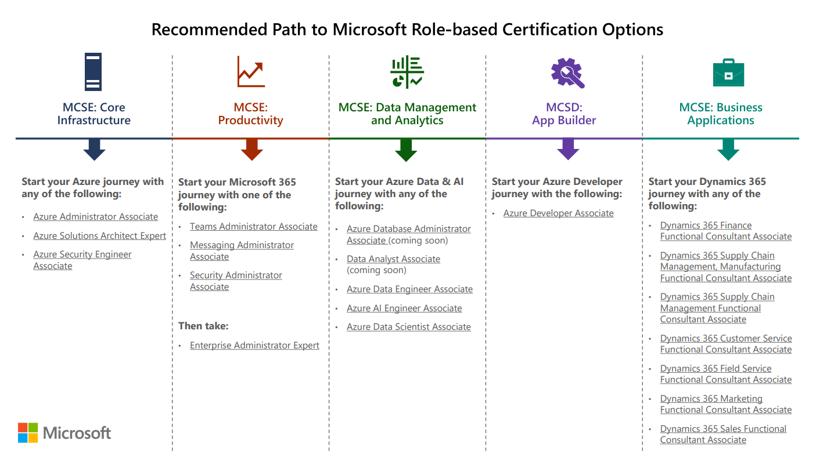
Role-based certs have replaced older certs
Notes:
So, first, What have they done with my MCSD/MCSE/MCSA?
If it starts with 70-, the exam is almost certainly already retired or will be retired by January 2021. That deadline was actually moved back six months because of COVID-19! This includes all exams associated with MCSA MCSD and MCSE, tho, the certifications themselves will remain on your official Microsoft transcript until no later than June 2022. Over the past few years, exams starting with letters like AZ, DP, AI, for example, are the newer exams you’re looking for.
Those older exams we’ve h all along were technology or platform based. Now, Microsoft exams are role based.
There will not be Windows Server 2019 and SQL Server 2019 certifications for those products, instead, there will be exams focusing on roles, like Solutions Architect, Enterprise Administrator, Azure Data Engineer, Azure Developer, Functional Consultant, etc. These roles are expected to have broad experience with all their relevant features and products.
Microsoft’s Emphasis is on Solutions has evolved over the last decade, and now we have these role-based certs and exams.
There is no such thing as a one-dimensional certification because there are few cases of one-dimensional jobs.
This is intentional and raises the value of a certification – a certification should mean you have broad experience.
Focus on practicality and actual usage.
Source: https://query.prod.cms.rt.microsoft.com/cms/api/am/binary/RE4q70G

Slide 11
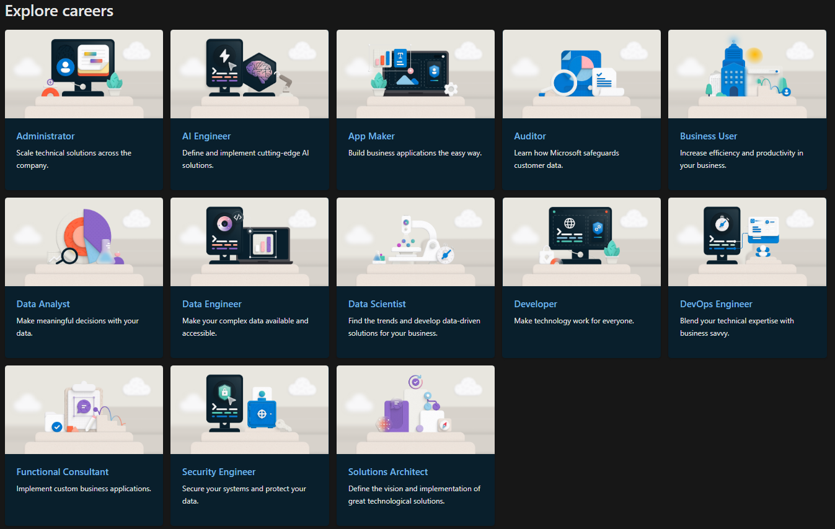
Career Paths
Notes:
Microsoft’s Emphasis is on Solutions has evolved over the last decade, and now we have these role-based certs and exams.
There is no such thing as a one-dimensional certification because there are few cases of one-dimensional jobs.
This is intentional and raises the value of a certification – a certification should mean you have broad experience.
Focus on practicality and actual usage.
These role-based certifications have to do with the job,
Not with the product. And when you pause and think about it, this makes a lot more sense for your career and your employer. You should have whole solutions experience, not narrow halfway experience.
Microsoft has a new career paths portal to identify your current or goal path and the certifications associated with them.

Slide 12
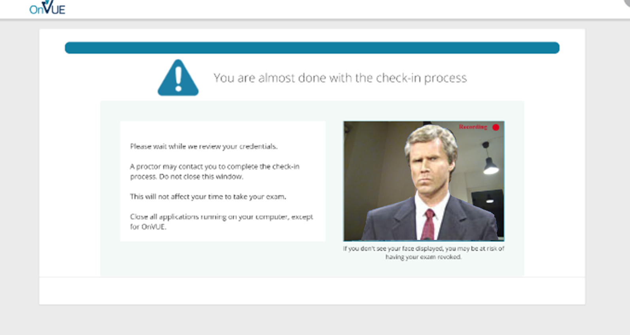
But Right Now? How?
Online Proctored Exams.
Notes:
So, last question. You’re wondering, with a pandemic, and hurricanes, and between all my hiding under the safety of the covers, how do I take a Microsoft Certification Exam? What testing center is even open this week?
Thankfully Pearson VUE and Microsoft had already offered online proctored exams, and they expanded this offering’s availability because many testing centers closed during the pandemic. It’s a live proctored exam, which means you’re taking the exam at your home or office, with someone actively watching you via a webcam and listening to you via your computer.
They for the most part work fine technically, though they are unforgiving. I took three online proctored exams since the pandemic started. Each time I took an exam, new security requirements were added that became stricter, as they looking for more things. My wife took an exam through Pearson in her field (in October 2022) and there were slightly different security and anti-cheating requirements too.
You have to take pictures of your testing area, from all angles, including the floor and ceiling, your ears and hair and glasses, etc. You have to cover any screens around you, erase any whiteboards, close any window blinds. This remote inspection process may take up to half an hour, so make sure to log into your exam early to give yourself plenty of time to go through their security process, and use the same browser, I recommend using Chrome, throughout.
There are stories out there of people walking through the room behind you, or hearing distant voices, and boom, the remote test monitor fails your exam with no refund. You are warned ahead of time, pretty clearly.
So make sure you’re taking your online proctored exam in a place where no one else can be seen or heard, including your kids. I put a sock on my home office door and told my wife and my college kid who is stuck at home, to not make any noise or enter the room for a couple hours. That’s what’s necessary.
Honestly, it’s worked pretty well for me so far, though my boss had issues with default web browser and lost his exam slot and had to fight for a refund. Even after the pandemic passes, I might still consider the online proctoring just because it saves hassle and travel. It works well.

Slide 13
Beta Exams
You can take new cert exams for new technology for significant discounts (not free any more, more like $20).
Follow the Microsoft Learn Blog for Beta announcements.
Notes:
For example, 300 registration codes were made available for AZ-303 and AZ-304, first come first serve.
With Beta Exams, you don’t find out whether or not you’ve passed right away. They evaluate the outcomes of the beta process and the questions. For example, in 2020 I took the DP-300 and DP-900 beta exams, and it’s been nearly two months and I still don’t know whether I passed.

Slide 14
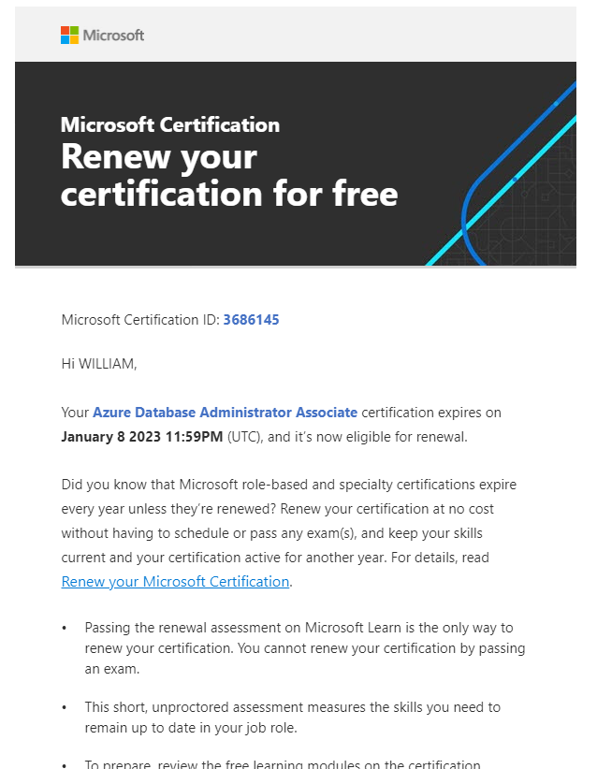
Certification renewal
Some certs renew annually, with nothing but a free online self-paced assessment.
You can take the assessment multiple times to renew.
Notes:
If you need to, you can take the assessment multiple times before the certification expiration date. There’s a 24-hour waiting period after the first attempt, but there’s no waiting period for any subsequent attempts.
I renewed my Azure Database Administrator cert with a short online assessment, free, and on-demand.

Slide 15
How To Prepare for Cert Exams
Review the domain of the exam.
Each exam comes with a study guide of the skills covered.
Unfamiliar features? Questions? Go study.
Something you’ve never done before? Try!

Slide 16
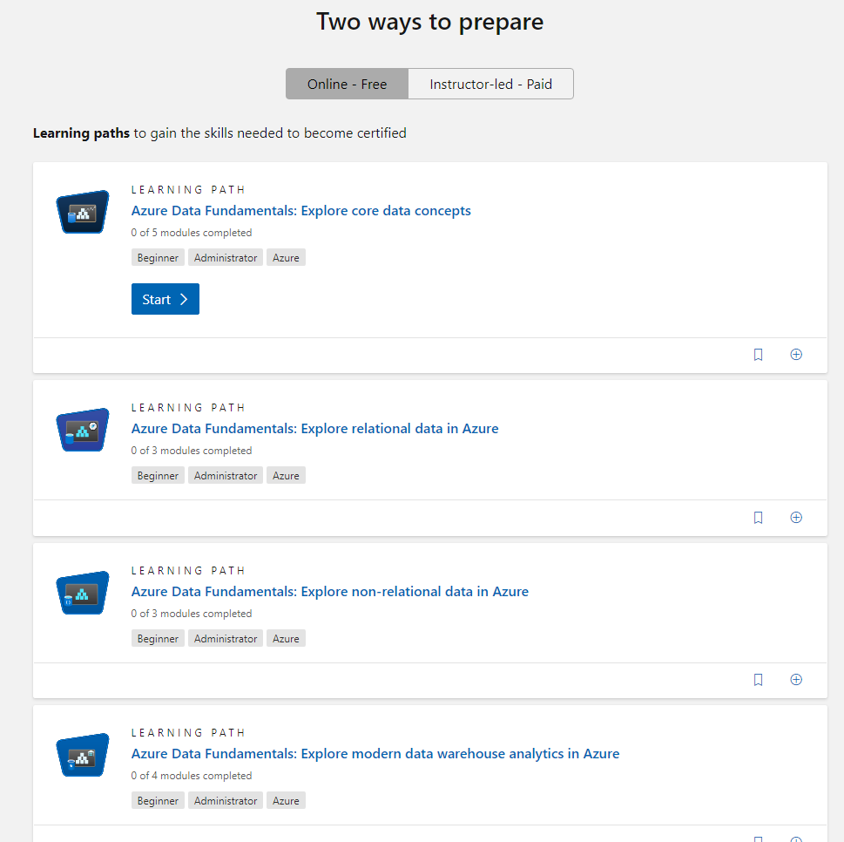
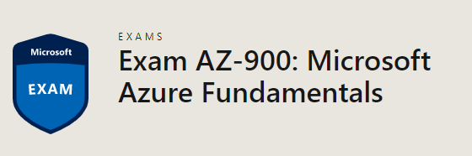
How To Prepare for Cert Exams
https://docs.microsoft.com/certifications/exams/az-900
Notes:
This is an example for AZ-900, the Azure Fundamentals exam. Highly recommend it by the way, for every professional, every consultant, every manager who works with Azure technologies. There are hours of free interactive training with review quizzes on the website.
That’s not all. In addition to the training modules in Learn for self-guided study and hands-on experience, Microsoft has more resources…

Slide 17
New Microsoft resources
Microsoft’s training content on Azure topics is good, with in-browser free sandboxes.
Actual Azure resources, for free!
Demo the exam experience
Become familiar with interface, question types
Many certification exams starting soon will have free 50-question practice assessments.
Practice exams rolling out in Jan 2023
Try it out with Security Fundamentals, SC-900
Notes:
Many exams are offering in-browser remote connections to azure Azure resources that live for up to four hours for you to get actual hands-on experience, completely for free.
<click>
The demonstration sandbox which mimics the exam look and feeling and lets you see the different types of questions in a website. You’ll see how the interface works for multiple choice, multiple select, drag and drop, build order lists, how exhibits work, and more. Use this demonstration of the questions to increase your familiarity and confidence going into the exam, especially if it is your first time taking a Microsoft certification exam.
<click>
Finally, Microsoft is now providing free practice exams with realistic technical questions. These practice assessments, starting in January 2023 with SC-900 are rolling out this year and will include all the fundamentals level exams.

Slide 18
How To Prepare for Cert Exams
Study by doing.
Lab environment at home or work, so you can build, break/fix, and learn.
Don’t have a test lab? Try to build one, it’s educational.
Invest time in your career.
Have a lab environment installed on your work/home PCs, or use Azure. (Free credits for students, new accounts, from work, etc.)
Use Learn sandboxes or other free labs.

Slide 19
How To Prepare for Cert Exams
Do not study only by reading books/online.
Use practice questions to find weak spots.
Memorization is rarely tested.
Though, you must know the subject material,
proper feature choice is likely to be tested.
For example, code sample questions are likely to test dependency or correct tactic, not syntax.

Slide 20
Constraints on Writers
The correct answer must be 100% correct.
The "distractors" must be plausible, but 100% wrong.
But exam writers can't make stuff up.
Every answer you see is something real. We write plausible real wrong answers.
For example:
In SQL Server, there is no such thing as “CHECKSUM Recovery Model,” so you won’t see it as a choice on an exam.
Notes:
Now I want to talk a bit about the experience of writing a cert exam, and what you can learn from that. I feel this was valuable experience for me to learn as a test taker myself.

Slide 21
Fun With Grammar
What "should you use" not "could use" or "would use“
"You need to" not "you must“
"By using" not "using“
"Named" not "called“
"You are developing" not "you are working on“
"by using the least amount of administrative effort" not "most efficiently" or "best” or “of course you’d do it this way”
"server that runs SQL Server" not "running SQL“ or “SQL server”
Also, if the word/phrase doesn't translate well, don't use it.

Slide 22
Fun With Grammar
The word "only" is a pain. It must be exact. Think translation!
Tonight we are serving enchiladas only.
Tonight we only are serving enchiladas.
Tonight only we are only serving enchiladas.
The "application only connects to one database”
vs.
the "application connects to only one database”
Notes:
Tonight we are serving enchiladas only. – that’s it for the menu
Tonight we only are serving enchiladas. – nobody else makes em
Tonight only we are only serving enchiladas. – tomorrow? Nope.
The "application only connects to one database” – doesn’t do anything else but connect, that doesn’t actually make sense.
vs.
the "application connects to only one database” – connects to only one database (more likely the intention)

Slide 23
“Best Practices”
Never assume a question is asking you for the “Best Practice.”
Something in the question will make the other answers wrong.
“Best Practices” are not testable but may be used as distractors.
We can’t test:
unenforced naming conventions or file extensions
generally accepted standard
the normal order for this
how it has always been done
“industry knowledge”

Slide 24
Writing Distractors
If two answers seem correct, there IS a differentiator somewhere in the question.
Read the question carefully, note details.
At some point, the question writer introduced a factor in the question to make sure there is only one right answer and all other options are 100% wrong.
Writing wrong answers is more difficult than correct!
Notes:
<click thru slide>
Now, writing the right answer is easy, and its opposite is easy (though sometimes too obvious).
Creating challenging wrong answers sometimes involves introducing new variables or twists to your question, and it is difficult to keep the question scenario simple while being complex enough to have 3 legitimate wrong answers. Let’s talk about domain drift, it’s a real problem for item writers with complex questions.

Slide 25
Item Writer - Question Drifting
“Domain Drift” is when your question became so complicated, you end up with a question on a different topic.
Notes:
<read slide first>
Now you have to beg another Item Writer on the team to trade question assignments with you.
For example, if you were supposed to ask a question about peanut butter sandwiches, and ended up asking a question about which whether utensils can spread creamy peanut butter… Stay with me

Slide 26
Question Structure
A question will include:
a Technical Scenario,
a Problem Statement and Requirements,
a Goal Statement,
and a Question Statement.
For example:
You are making a sandwich.
You must make the sandwich with peanut butter.
You need to choose a utensil.
Which do you choose?

Slide 27
Writing the Wrong Answers Is Most Difficult
So your easy multiple-choice answers become:
Fork.
Spoon.
Knife.
Spork.
And everyone knows a knife is correct, right?
For example:
You are making a sandwich.
You must make the sandwich with peanut butter.
You need to choose a utensil.
Which do you choose?

Slide 28
Writing the Wrong Answers Is Most Difficult
But you can probably spread peanut butter with any of those, if you try hard enough. You cannot test “Best Practices” or “Industry Standards” for peanut butter distribution. So you change your Goal Statement.
For example:
You are making a sandwich.
You must make the sandwich with peanut butter.
You need to choose a utensil that will spread the peanut butter by using the least amount of administrative effort.
Which do you choose?

Slide 29
Writing the Wrong Answers Is Most Difficult
But says who?
Spoons and Sporks have virtually the same peanut butter delivery factors,
and it could be argued by some cultures that forks are the superior peanut butter-handling implements.
For example:
You are making a sandwich.
You must make the sandwich with peanut butter.
You need to choose a utensil that will spread the peanut butter by using the least amount of administrative effort.
Which do you choose?

Slide 30
Writing the Wrong Answers Is Most Difficult
So you complicate your question to test the exam-takers peanut butter solutions delivery experience…
For example:
You are making a sandwich.
You must make the sandwich with peanut butter and cut the sandwich in half using the same utensil.
You need to choose a utensil that will spread the peanut butter by using the least amount of administrative effort.
Which do you choose?

Slide 31
Writing the Wrong Answers Is Most Difficult
Now spoons are definitely out. You can’t cut bread with a spoon, it’s science.
But sporks and forks? Those could still get the job done, as well as a knife.
But spork and fork are not 100% wrong (yet)!
So you change your question again…
For example:
You are making a sandwich.
You must make the sandwich with peanut butter and cut the sandwich in half using the same utensil.
You need to choose a utensil that will spread the peanut butter by using the least amount of administrative effort.
Which do you choose?

Slide 32
Writing the Wrong Answers Is Most Difficult
Now spoons are definitely out. You can’t cut bread with a spoon, it’s science.
But sporks and forks? Those could still get the job done, as well as a knife.
But spork and fork are not 100% wrong (yet)!
So you change your question again…
For example:
You are making a sandwich.
You must make the sandwich with peanut butter and cut the sandwich in half using the same utensil. You do not have access to a hybrid utensil environment.
You need to choose a utensil that will spread the peanut butter by using the least amount of administrative effort.
Which do you choose?

Slide 33
Writing the Wrong Answers Is Most Difficult
Boom, now Sporks are CLEARLY not allowed (for no good real-life reason, only one made up for this question). An answer is made 100% wrong.
But forks remain a problem…
For example:
You are making a sandwich.
You must make the sandwich with peanut butter and cut the sandwich in half using the same utensil. You do not have access to a hybrid utensil environment.
You need to choose a utensil that will spread the peanut butter by using the least amount of administrative effort.
Which do you choose?

Slide 34
Writing the Wrong Answers Is Most Difficult
There’s no way you could spread creamy peanut butter with a fork, right?
Ta Da!
Sigh.
And that’s why cert exam questions take FOREVER to read.
For example:
You are making a sandwich.
You must make the sandwich with creamy peanut butter and cut the sandwich in half using the same utensil. You do not have access to a hybrid utensil environment.
You need to choose a utensil that will spread the peanut butter by using the least amount of administrative effort.
Which do you choose?

Slide 35
Writing the Wrong Answers Is Most Difficult
Notice all the little details that may seem extraneous at first.
This isn’t a question about sandwiches. This isn’t really even a question about peanut butter.
It’s a question about the details of solution selection.
For example:
You are making a sandwich.
You must make the sandwich with creamy peanut butter and cut the sandwich in half using the same utensil. You do not have access to a hybrid utensil environment.
You need to choose a utensil that will spread the peanut butter by using the least amount of administrative effort.
Which do you choose?

Slide 36
Understand construction to deconstruct
What did we start writing a question about?
Utensils.
What did we end up writing a question about?
Bread geometry, peanut butter viscosity.
Notes:
And now you understand why it’s challenging to write exam questions about simple concepts, and why exam questions sometimes feel weighed down by different variables and factors. It’s why creating huge case study type questions, with several pages of information as the source of several questions, actually works out pretty well.
This is an important exercise for you to understand how questions were constructed, to recognize how these extra details were added as the question evolved, so that you can deconstruct the questions on a test.

Slide 37
Give it a Try
Questions?
Then, Let’s give it a shot!
Notes:
<Notes first>
Before we go into some sample questions together, are there any questions?
<click>

Slide 38
Remember this?
You are a member of the Council of Elrond.
You must choose someone present to bring the One Ring to Mordor. One does not simple walk into Mordor. The ring-bearer must not be desirous to use the ring to help their own kingdom. The ring-bearer must not own another of the Rings of Power.
You need to choose a ring-bearer.
Who should you choose?
A. Smeagol
B. Boromir of Gondor
C. Frodo Baggins
D. Gandalf the Grey
Notes:
<click>
Gandalf already owns Narya, the Ring of Fire, one of the three Rings of Power made for the Elves.
<click>
Boromir is pretty much planning all along to get the ring back to the men of Gondor, his father the steward Denethor the Second.
<click>
Smeagol is tricky because of course you’d rule out Smeagol, he’s been left twisted and consumed by the evil of the One Ring, but again, test questions will not use industry knowledge or assumptions or best practices, the wrong answers have to be 100% incorrect. In this case, <click>Smeagol was not present at the Council of Elrond, making this answer 100% incorrect, leaving nothing to doubt.

Slide 39
Question 2
You are a European travel planner.
Your client wants to plan a vacation in the Schengen Area. The countries must be in the European Union and use the Euro as currency.
You need to choose an itinerary for your client’s vacation.
Which country must you not choose?
A. Germany
B. Denmark
C. Croatia
D. Portugal
<- Joined the EU, €, and Schengen area on January 1 2023
Notes:
All of these answer are in the Schengen area. This could be a distraction to the unqualified candidate.
<next>
Croatia is part of the question intentionally present to test resent content on the test. You should expect this as a test taker, and as an exam item write, we would likely be given questions specifically to test recent changes, features, facts.
<next>
Denmark, while in the Euro and the Schengen, has a special exception out of the Euro and uses the Danish Kroner.
<next>
Now, this question was still fairly straightforward. Three of the countries are in the EU and use the Euro, even if one was a trick. What question details or answers could have used to make this question more difficult? Perhaps, to make Germany or Portugal wrong for different reasons, or, to use a different wrong answer?

Slide 40
Question 3
You are a photographer for a nature magazine.
You must choose an island with a human population of at least 1 million. It must be among the Top 10 islands by size and home to a mountain in the Top 50 tallest peaks.
You need to choose an island for an upcoming nature documentary.
Which island should you choose?
A. Honshu
B. Madagascar
C. Iceland
D. Victoria Island
Notes:
Honshu, in Japan, of course is home to Mount Fuji, the 35th tallest mountain in the world.
Victoria Island in northern Canada has a population of only 2000+ people, mostly Inuit.

Slide 41
Question 4
You are the reel operator of a local cinema.
You must prepare a private showing of a film for a corporate event. The film must be a science fiction film featuring both alien(s) and android(s). You must not choose a film that features any raccoon(s).
You need to choose a film for the screening.
Which film should you screen?
A. Guardians of the Galaxy Vol 2
B. Blade Runner
C. Interstellar
D. Aliens
Notes:
Both Interstellar and Blade Runner have no aliens.
<next>
Interstellar has no androids.
<next>
Guardians of the Galaxy famously features a raccoon, leaving Aliens as the logical choice.

Slide 42
Question 5
You are an astronaut looking to land on a planet in this solar system.
Your new space base requires a solid surface. Your space base is equipped with a moon roof.
You need to choose a location for your new space base.
Which planet should you choose?
A. Jupiter
B. Venus
C. Pluto
D. Mars

Slide 43
Question 6
You are the athletic director of a university.
The dean has instructed you to grow the athletics program. You must choose a new varsity sport that uses spherical balls. The sport must sell tickets in the university’s outdoor grass turf venue to anyone.
You need to choose a new sport program.
What sport should you choose?
A. Basketball
B. Football (or Soccer…)
C. American Football
D. Quidditch
Notes:
Alright, now I’ve done Lord of the Rings, how about some sports right, yeah!
…
Of course this was a trick question also about Harry Potter, very much still for the geeks in the audience.

Slide 44
Question 7
You are an admiral in Starfleet.
Your new flagship needs a captain. You may choose any out of the ranks of captains… throughout time. The captain must have never willingly cooperated with the Borg. Because of the long voyage, the captain must have no children to leave behind. The new captain must have a superior hairstyle.
You need to choose a leader for your starship.
Who captain should you choose?
A. James T Kirk
B. Jean-Luc Picard
C. Benjamin Sisko
D. Kathryn Janeway

Slide 45
Question 8
You are the biologist at a natural freshwater wetland preserve.
You have been instructed to reduce the local mosquito population. You must choose an animal that predates on mosquitos in the larval stage.
You need to choose a natural mosquito predator.
Which animal should you choose?
A. Vermilion snapper (rhomboplites aurorubens)
B. Purple martin (progne subis)
C. Brown Bats (ptesicus fuscus)
D. Mosquitofish (gambusia affinis)
Notes:
Purple martins and bats actually do not do that much damage to mosquito populations, despite their reputation. And when they do eat mosquitos, they eat the adult flying stage.
Vermillion snapper is a saltwater fish
TODO For this question, what else could you have offered as a wrong answer? What details could you have introduced?

Slide 46
Question 9
You are the bartender of a local fine dining establishment.
You are instructed to serve an appropriate spirit to a diner. Your establishment only serves whiskeys aged in American oak barrels. The diner has requested a malt whiskey from outside of Tennessee. The malt must not contain corn.
You need to choose a spirit.
Which spirit should you serve?
A. Scotch Whisky
B. Bourbon
C. Tennessee Whiskey
D. Cognac
Notes:
…
End: Ok, so now I’ve done movies and sports and fantasy and science fiction and alcohol, I must have had a question for everyone in the audience.

Slide 47
Helpful Links
http://www.sqltact.com/2012/04/certification-exams-from-other-side.html
http://www.sqltact.com/2016/07/training-to-do-list-for-new-dba.html
https://www.sqltact.com/2023/01/so-youre-considering-pursuing.html
https://docs.microsoft.com/certifications/
https://docs.microsoft.com/certifications/posts/new-role-based-certification-and-training-is-here
https://docs.microsoft.com/certifications/posts/skill-up-and-stand-out-with-new-role-based-training-and-certification
https://docs.microsoft.com/certifications/exams/az-900
Microsoft Learn Blog: https://techcommunity.microsoft.com/t5/microsoft-learn-blog/bg-p/MicrosoftLearnBlog

Slide 48
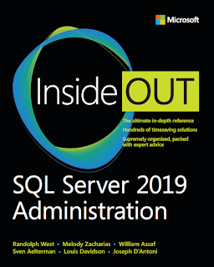
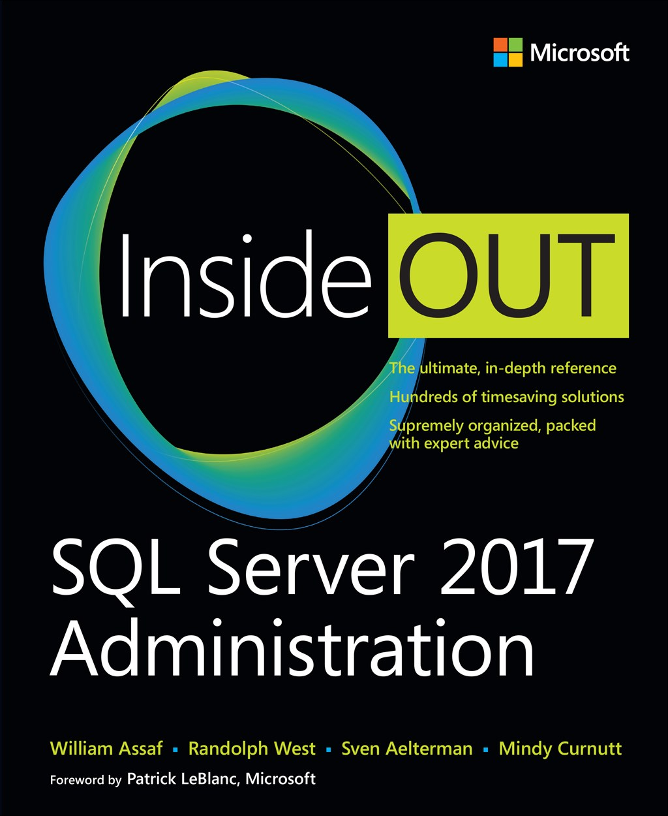
SQL Server 2017 Inside Out
SQL Server Administration Inside Out
by Microsoft Press
2017 published Feb 2018
2019 published March 2020
2022 coming March 2023

Slide 49
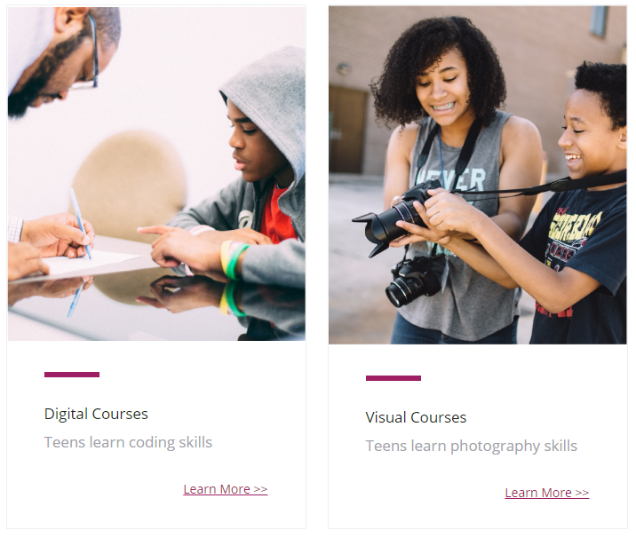
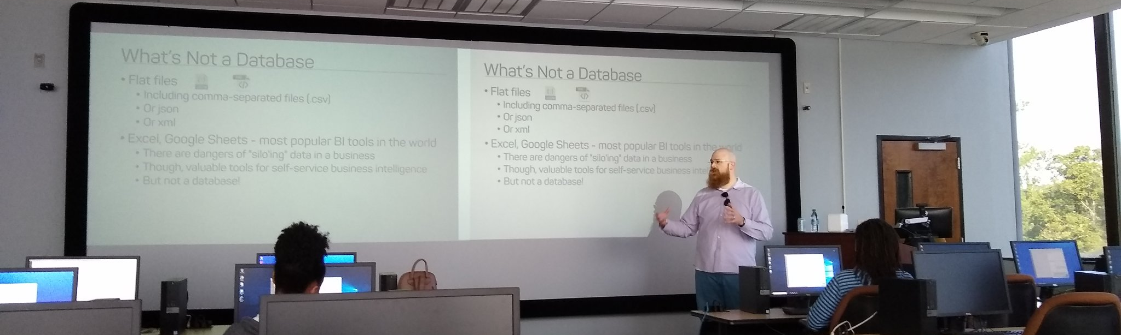
Support your Local STEM Initiatives
I encourage you to find, then donate time and money to local STEM education initiatives where you live. Get involved!
There is almost certainly some nonprofit where you live that needs your enthusiasm and skills to close the achievement gap.
https://www.thewallsproject.org/programs/futures_fund/
Notes:
Here’s a STEM education nonprofit local to me that I volunteer for, please reach out and share your knowledge with the next generation, and especially with folks in your community that are needing to find new careers during the pandemic.

Slide 50
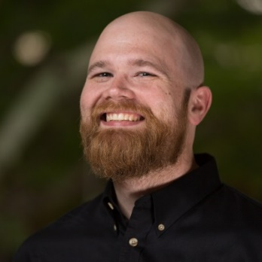

William Assaf
Senior Content Dev, Microsoft Database Docs, Azure SQL DB lead
DBA Consultant, Manager
MS Cert exam SME
Former MSFT MVP, Data Platform
Co-author, Microsoft Press SQL Server Administration Inside Out 2017 and 2019 and 2022.
Senior Content Developer, Microsoft
SQLTact.com
linkedin.com/in/williamdassaf
Notes:
This presentation is available for download at my blog SQLTact.com.
I just posted a two-part blog series written with a colleague of mine, a doctor in computer science, about test taking, certification exams, and more on my blog at SQLTact.com, check that out next and best of luck on your next exams.

